Slide 1
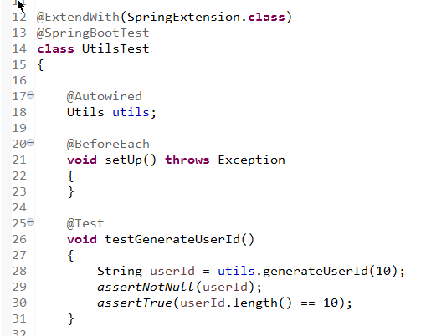
JUnit Integration Test - Testing JWT Tokens and UserId

